Slide 1
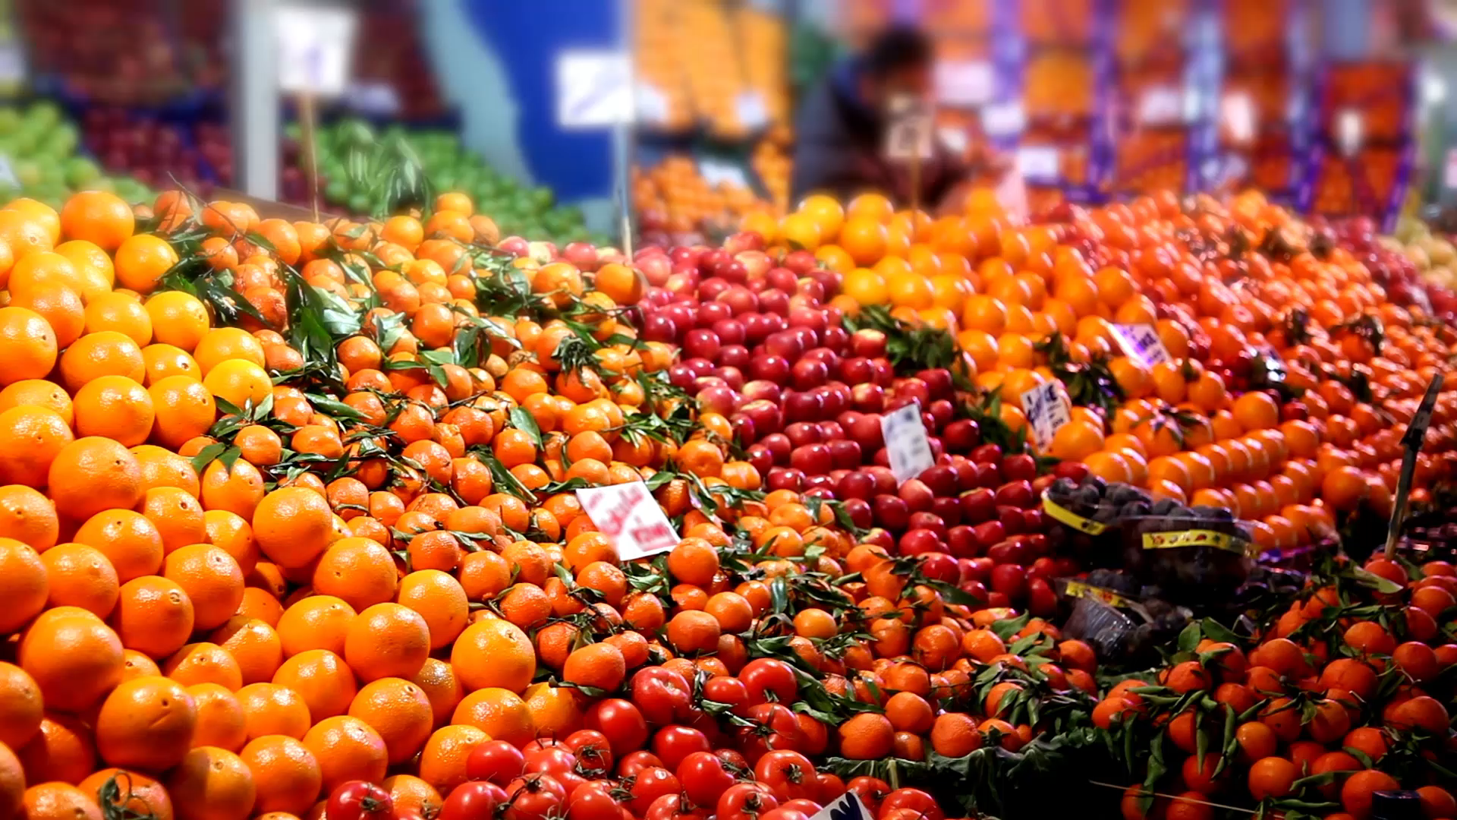
You can’t Afford not to be Fruitful (Part 1)
John 15:16

Slide 2
Introduction
You were not redeemed to be unprofitable, you were not saved to be unfruitful, and you were not called to be a Christian just to be a number in the crowd, but you are redeemed to be fruitful, to bear fruits and be a blessing to both believers and unbelievers, to affect your world and even the Kingdom of God.
That is why He chose you among so many people from your families, towns, communities, age-mates, and so on.
So, when Jesus said, ‘I chose you…that you might…bear fruit – fruit that will last,’ He was saying, ‘Spend your life in pursuit of that which has lasting significance and eternal value!’

Slide 3
What does He mean by ‘fruit’?
‘The fruit of the Spirit is love, joy, peace, forbearance, kindness, goodness, faithfulness, gentleness and self-control’ (Galatians 5:22-23 NIV). Those nine qualities describe the only life that’s truly worth living.

Slide 4
The Goodnews
He knows you cannot do it by yourself, hence, he’s ready to help you.
Fortunately, you’re not left to produce this kind of fruit by self-effort. Indeed, you may as well try to pick yourself up by your own bootstraps!
No, Jesus said this: ‘I am the true vine, and my Father is the gardener. He cuts off every branch in me that bears no fruit, while every branch that does bear fruit, he prunes so that it will be even more fruitful…No branch can bear fruit by itself; it must remain in the vine. Neither can you bear fruit unless you remain in me. I am the vine; you are the branches. If you remain in me and I in you, you will bear much fruit; apart from me you can do nothing’ (John 15:1-2, 4-5 NIV).

Slide 5

Who is Jesus speaking to?
You and I. The Believers. ‘Every branch in me’ (v. 2 NIV).

Slide 6
Who is the gardener?
‘My Father is the gardener’ (v. 1 NIV).

Slide 7
What’s His goal?
For you to be ‘even more fruitful’ (v. 2 NIV).

Slide 8
What’s the secret of fruitfulness?
Constant contact and intimacy with Jesus. ‘If you remain in me and I in you, you will bear much fruit’ (v. 5 NIV).
So, if you want to be more fruitful, draw closer to the Lord.

Slide 9
Conclusion
You need to renew your intimacy with Jesus, go back to the basis. More Bible reading, more fellowship with Him, more prayers.
Just more of Him and less of yourself and you will be fruitful.

Slide 10
Prayer
Pray that the Holy Spirit will help you to be more connected to the SOURCE, that is JESUS than ever before

